Slide 1





TEAM ACHIEVERS
E-COMMERSE INSIGHTS
Insights into Sales, Analysis, and Market trends at a glance.

Slide 2



Objective :
The purpose of an e‑commerce ML model focused on customer prediction is to anticipate what each customer will do next so businesses can act proactively to grow revenue, improve retention, and cut risk.
This helps to:
Purchase likelihood: probability a customer will buy in a given window, enabling targeted offers and reminders.\
Next‑best‑action/product: personalized recommendations based on behavior, preferences, and context.
Customer lifetime value (CLV): expected long‑term revenue per customer to guide budget and priority.

Slide 3

Dataset Overview
Key Fields:
Developed a machine learning model to predict monthly sales and promotion impact to support inventory planning and marketing allocation.
Analyzed e‑commerce sales across Indian cities (Mumbai, Pune, Varanasi, Bengaluru, New Delhi) to track revenue, discounts, customer segments, and regional patterns.
Built interactive sales dashboards in Excel (with PivotTables, PivotCharts, slicers), plus companion dashboards in Tableau and Power BI for comparison and distribution.

Slide 4
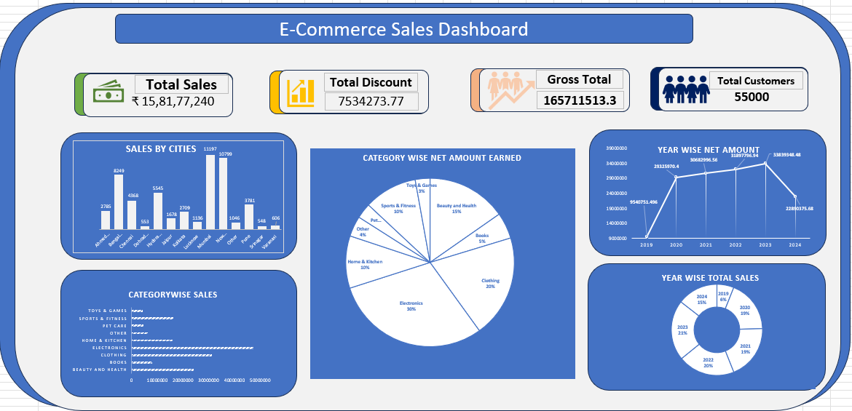

Excel Dashboard
Key Visuals :
Total Sales:
how much the company has made
Sales by Cities : Which city makes the most sales
Year wise Net amount:
Total sales per year.
Category wies Sales:
How much sales Each category makes
Total Customers :
Gives Insights of Customers count
Using Excel, we designed a professional interactive dashboard for deeper visual storytelling and user exploration.

Slide 5
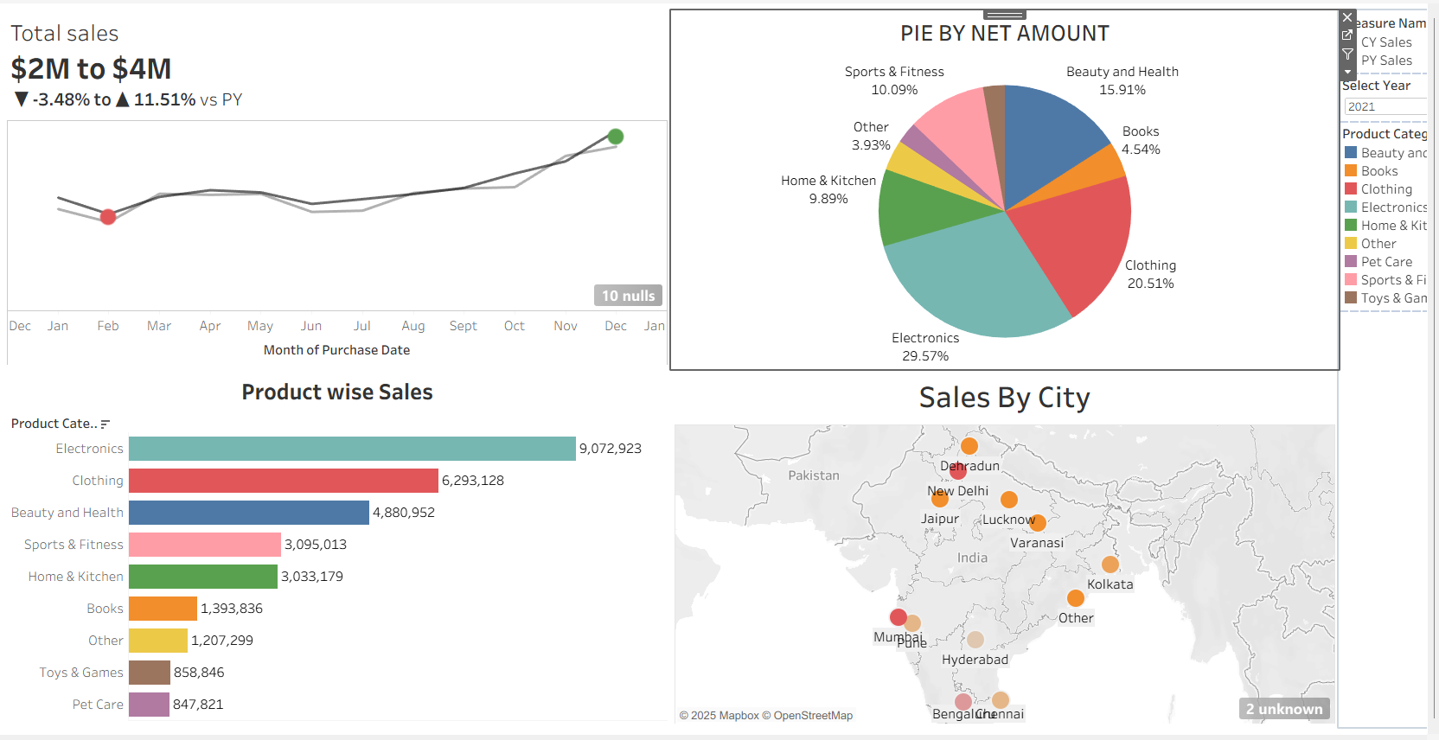
Tableau Dashboard
Features include:
We developed a professional, interactive dashboard in Tableau to empower users with dynamic visual storytelling and intuitive data exploration.
Total Sales KPI : Total Sales with last year profit and loss
Top 10 Sales Category Bar Chart : Most in-demand Products.
Net Amount Pie Chart : Product category with Percentage
Geographic Map : Most Sales by City insights in a Geographic map
Interactive Filters:

Slide 6
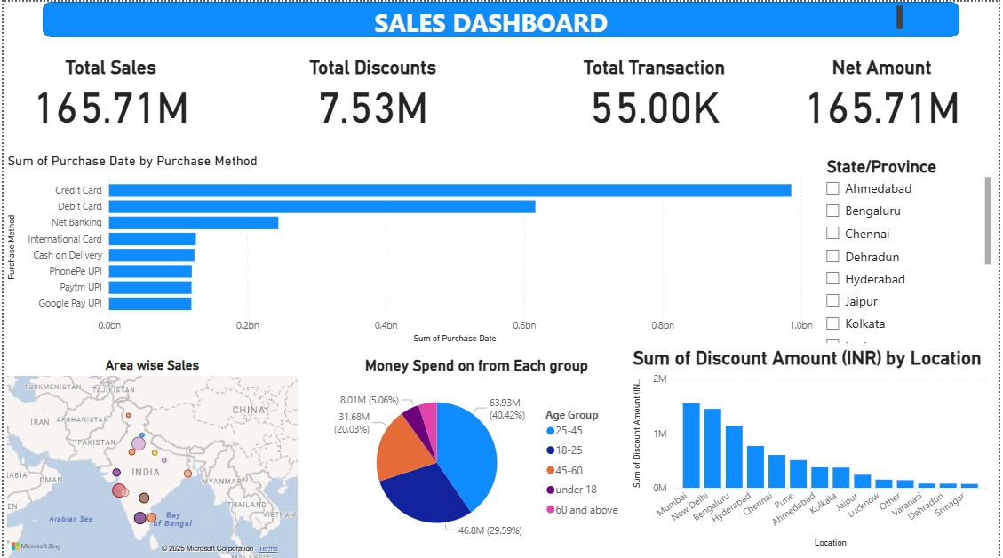
Power BI Dashboard
Features include:
We developed a professional, interactive dashboard in Tableau to empower users with dynamic visual storytelling and intuitive data exploration.
Total Sales KPI : Total Sales with last year profit and loss
Top 10 Sales Category Bar Chart : Most in-demand Products.
Net Amount Pie Chart : Product category with Percentage
Geographic Map : Most Sales by City insights in a Geographic map
Interactive Filters:

Slide 7

Key Insights
Total Sales
Month and year wise Sales
Trends Analysis
Total sales of each year and Total year
Covers monthly sales with Profit Loss function
Future trends can be predicted through previous chats
Geographic Insights
Current Inventory
Cities like New Delhi, Bengaluru, Mumbai, Pune, and Varanasi
are major hubs for Sales.
Insights covering the Current inventory Status

Slide 8

Machine Learning component
Machine learning component:
Supervised regression for monthly sales prediction by city/category using historical sales, discount signals, seasonality (month), and events.
Model evaluation with hold‑out/TimeSeries split and error metrics scenario testing for discount changes.

Slide 9
Advantages
Centralized visibility of KPIs across cities and categories; faster decisions on pricing, inventory, and marketing.
Standardized metrics and automated refresh reduce manual consolidation and errors.
Predictive insights improve demand planning and campaign timing, potentially reducing stockouts/overstock.

Slide 10
Disdvantages
Maintaining dashboards in three tools increases governance, version control, and training overhead.
Data quality issues (missing values, inconsistent categories) can degrade both dashboards and predictions.
ML risks: overfitting, data leakage, and concept drift; requires careful validation, monitoring, and periodic retraining.
Excel performance can degrade with very large datasets; may need Power Query, data model optimization, or external storage.

Slide 11
Conclusion
Business impact: higher conversion/AOV, lower churn and acquisition cost, improved inventory and staffing plans, and more accurate revenue forecasts.
Deployment: real‑time scoring in app/site for recommendations; batch scoring for weekly campaigns and retention lists; A/B testing to measure uplift.
Guardrails: prevent data leakage with time‑based splits, monitor drift and retrain, audit for bias/privacy, and explain key drivers for stakeholder trust.

Slide 12


THANK YOU!
Team Achiver

